Slide 1

ICT502
Week 10: Ethical and Management Issues in IT Projects
ICT502 Applied IT Project A
1

Slide 2
What we learned last week
Methods of Project Evaluation
Critical Reflection on Project Performance
Integration of Evaluation into Project Management
Impact Assessment and Stakeholder Feedback
Incorporating Lessons Learned into Future Projects

Slide 3
Ethics and Governance in IT Projects
This week students learn:
- ethical issues in modern IT systems,
- responsible use of emerging technologies,
- IT governance and compliance,
- stakeholder management,
- and how these connect to Assessment 4.

Slide 4
Why Ethics Matter in IT Projects
Technology Can Create Risks
Modern technologies such as:
- AI,
- cloud computing,
- cybersecurity systems,
- IoT,
- and data analytics
can create ethical and legal challenges if not managed properly.

Slide 5
Ethics in Real IT Companies
Companies Like NSW IT Support Must Consider:
- data privacy - cybersecurity - responsible AI use - client confidentiality - system reliability - compliance with Australian regulations
Ethics is not optional in IT projects.

Slide 6
Connecting Week 10 to Assessment 4
Students Must Include:
- ethical considerations,
- security risks,
- governance,
- compliance,
- stakeholder communication,
- and risk management.

Slide 7
Connecting Week 10 to Assessment 4
These directly support:
- Section 5 (Ethical & Management Issues)
- Section 6 (Communication Strategy)

Slide 8
Common Ethical Issues in IT Projects
Ethical Issue | Example
Data privacy | client information exposed
AI bias | unfair automated decisions
Cybersecurity breaches | hacked systems
Poor accessibility | systems difficult for users
Misuse of data | collecting unnecessary data

Slide 9
Questions Students Can Ask NSW IT Support
About Ethics
Useful Questions:
- What cybersecurity risks concern clients most?
- How do you protect customer data?
- How do you manage privacy and confidentiality?
- Do clients ask about compliance requirements?
- What ethical challenges are common in IT support projects?

Slide 10
Australian Context (Very Important)
Students Should Think About:
Australian IT Challenges
- cyber attacks on SMEs
- privacy regulations
- cloud security
- AI ethics
- remote work security
- ransomware attacks
Assessment 4 should reflect real Australian industry issues.

Slide 11
Australian Regulations Students Should Mention
Important Examples:
- Australian Privacy Act
- Data protection principles
- Cybersecurity best practices
- Company policies and procedures
Students do not need deep legal knowledge, but should show awareness.

Slide 12
Example Ethical Problem
Problem:
AI ticketing system incorrectly prioritises customer requests.
Risks:
- unfair treatment,
- customer dissatisfaction,
- inaccurate decisions.

Slide 13
Example Ethical Problem
Possible Solutions:
- human review - regular testing - transparent AI rules - staff oversight

Slide 14
Questions About Governance
Students Can Ask:
- How do you manage IT risks?
- What policies do you follow?
- How do you manage user access permissions?
- How do you ensure compliance?
- How do you monitor system security?

Slide 15
IT Governance Explained Simply IT Governance Means
Making sure:
- IT systems support business goals,
- risks are managed,
- security is maintained,
- and policies are followed.

Slide 16
Example Governance Challenges
Challenge | Possible Student Solution
weak password management | MFA authentication
poor access control | role-based access
unpatched systems | automated updates
lack of monitoring | security dashboard

Slide 17
Stakeholder Management
Important Stakeholders:
- clients,
- managers,
- IT engineers,
- support staff,
- project teams,
- end users.

Slide 18
Why Stakeholder Management Matters
Poor stakeholder management can cause: X misunderstandings X delays X unhappy clients X project failure

Slide 19
Why Stakeholder Management Matters
Good communication improves: - trust - collaboration - project success

Slide 20
Questions Students Can Ask NSW IT Support
About Stakeholders
Good Questions:
- How do you manage client expectations?
- What communication problems happen most often?
- How do you handle difficult clients?
- How do you explain technical issues to non-technical users?
- How do teams coordinate during projects?

Slide 21
Managing Client Expectations
Important Lesson:
- Clients may expect:
- faster systems,
- lower cost,
- perfect security,
- instant support.

Slide 22
Managing Client Expectations
Project teams must: - communicate clearly - explain limitations - provide realistic timelines

Slide 23
Example Assessment 4 Ethical Discussion
Example
The proposed AI-assisted ticketing system may create risks related to inaccurate prioritisation and client data privacy. To reduce these risks, the system will include human oversight, encrypted storage, and role-based access controls to ensure ethical and secure operation.
This is the level students should aim for.

Slide 24
Example Challenges & Student Solutions
NSW IT Support Challenge | Possible Solution
phishing attacks | cybersecurity awareness training
data privacy concerns | encrypted cloud storage
client communication delays | customer portal
access control problems | MFA and role-based access
remote work risks | VPN and endpoint security

Slide 25
Professional Questions Students Should Ask
Instead of:
“What software do you use?”
Better Questions:
- Why was this security solution chosen?
- What risks were considered?
- How do clients respond to this technology?
- What ethical concerns exist?
- What governance policies support this system?
These questions show critical thinking.

Slide 26
Common Mistakes in Assessment 4
X ignoring ethics X no cybersecurity discussion X weak stakeholder analysis X no governance discussion X unrealistic solutions X no Australian context

Slide 27
Final Advice for Students
High-Quality Assessment 4 Reports:
- solve real business problems - include ethical considerations - discuss governance and compliance - manage stakeholder needs - justify security decisions - connect technology to business value

Slide 28
Final Message
Think Like a Responsible IT Professional
Ask yourself:
- Is my solution ethical?
- Is customer data protected?
- Are risks managed properly?
- Would stakeholders trust this system?
- Does this solution fit Australian business needs?

Slide 29
Key Lessons/Messages from Week 10 Topic
1. Ethics is important in IT projects
Technology should be used responsibly and fairly. IT systems must protect users and organisations from harm.

Slide 30
Key Lessons/Messages from Week 10 Topic
2. Emerging technologies create both opportunities and risks
Technologies like:
- AI,
- cloud computing,
- IoT,
- and cybersecurity systems
can improve businesses, but they may also create privacy, security, or ethical problems.

Slide 31
Key Lessons/Messages from Week 10 Topic
3. IT governance helps organisations manage IT properly
IT governance ensures:
- systems support business goals,
- security is maintained,
- risks are controlled,
- and policies are followed.

Slide 32
Key Lessons/Messages from Week 10 Topic
4. Cybersecurity and privacy are major concerns in Australia
Australian businesses must protect customer data and reduce cyber risks such as:
- hacking,
- phishing,
- ransomware,
- and data breaches.

Slide 33
Key Lessons/Messages from Week 10 Topic
5. Stakeholder management is critical
IT projects involve many stakeholders:
- clients,
- managers,
- engineers,
- and end users.
Good communication improves project success.

Slide 34
Key Lessons/Messages from Week 10 Topic
6. Ethical decision-making is part of project management
Project teams must think about:
- fairness,
- privacy,
- accessibility,
- transparency,
- and responsible use of technology.

Slide 35
Key Lessons/Messages from Week 10 Topic
7. Students should think beyond technology
A successful IT solution is not only technically correct. It must also:
- be secure,
- ethical,
- realistic,
- and useful for stakeholders.

Slide 36
Discussion Questions
Why are ethics important in IT projects?
Ethics help ensure technology is used responsibly, fairly, and safely for users and organisations.
2. What are some common ethical issues in IT systems?
Common issues include data privacy, cybersecurity risks, AI bias, and misuse of customer information.

Slide 37
Discussion Questions
3. What is IT governance?
IT governance means managing IT systems properly to support business goals, security, and compliance.
4. Why is cybersecurity important for Australian businesses?
Australian businesses face cyber threats such as hacking, phishing, and ransomware, so protecting systems and customer data is very important.

Slide 38
Discussion Questions
5. Who are stakeholders in an IT project?
Stakeholders include clients, managers, employees, project teams, and end users affected by the project.
6. Why is communication important in stakeholder management?
Good communication helps reduce misunderstandings, improve trust, and keep projects running smoothly.

Slide 39
Discussion Questions
7. Give one example of an ethical solution for an AI system.
Adding human review and protecting user data with encryption are examples of ethical solutions.
8. How can NSW IT Support improve stakeholder relationships?
They can improve communication, provide regular updates, listen to client feedback, and explain technical issues clearly.

Slide 40
Week 10 Pre-Class Readings
YouTube Video (Please review in 10 minutes):
Importance of ethics in Project Management:
https://www.youtube.com/watch?v=TSg0U8xIukY

Slide 41
Week 10 Pre-Class Readings
Key lessons/messages from the video: Ethics in Project Management
1. Ethics is very important in project management
Project managers should make fair, honest, and responsible decisions.
2. A project manager should not be a “bad cop”
Some people think project managers must shout, pressure people, or act harshly. The video explains this is wrong.

Slide 42
Week 10 Pre-Class Readings
3. A good project manager should be neutral
A project manager should not take sides. They should make unbiased decisions based on facts.
4. Bribery is always wrong
Even if bribery helps finish a project on time, it is still unethical and should not be accepted.

Slide 43
Week 10 Pre-Class Readings
5. Favouritism is also unethical
Giving benefits or contracts to friends instead of the best person or company is unfair.
6. Ethics builds trust
When project managers are honest and fair, stakeholders trust them more.

Slide 44
Week 10 Pre-Class Readings
7. Ethics improves business relationships
Clients and partners are more likely to work again with people who act professionally and honestly.
8. Ethical decisions reduce project risk
When problems are openly discussed and not hidden, the project becomes safer and easier to manage.

Slide 45
Week 10 Pre-Class Readings
9. Doing the right thing leads to better results
Unethical actions may create stress, conflict, and project failure. Ethical actions support long-term success.
10. Main lesson
A successful project manager is not just someone who finishes the project. A successful project manager completes the project in a fair, honest, and ethical way.

Slide 46
Discussion Questions
1. Why is ethics important in project management?
Ethics helps project managers make honest, fair, and responsible decisions.
2. Should a project manager accept bribery to finish a project on time?
No. Bribery is unethical, even if it helps complete the project faster.

Slide 47
Discussion Questions
3. What does it mean for a project manager to be neutral?
It means the project manager does not take sides and makes fair decisions based on facts.
4. Why is favouritism a problem in projects?
Favouritism is unfair and can lead to poor decisions, conflict, and loss of trust.

Slide 48
Discussion Questions
5. How does ethical behaviour build trust?
When people see that a project manager is honest and fair, they are more likely to trust and respect them.
6. How can ethics reduce project risk?
Ethics encourages transparency. Problems are discussed early instead of being hidden.

Slide 49
Discussion Questions
7. What is the main message of the video?
Project managers should be honest, fair, neutral, and responsible. Finishing a project is important, but doing it ethically is more important.

Slide 50

Pre-Class Discussion
YouTube Video: (Watch the video in 2 minutes)
AI Ethics: Why It Matters?
https://www.youtube.com/watch?v=C2MWrCdGG0Q

Slide 51
Pre-Class Discussion
Key lessons/messages from the video: AI Ethics
1. AI is already part of daily life
Artificial Intelligence (AI) is not just futuristic technology. It is already used in:
- customer service,
- online shopping,
- automation,
- recommendations,
- and business operations.

Slide 52
Pre-Class Discussion
2. AI can improve businesses and productivity
AI helps organisations:
- save time,
- automate tasks,
- improve customer experience,
- increase productivity,
- and improve business performance.

Slide 53
Pre-Class Discussion
3. AI also creates ethical concerns
If AI is not used properly, it may:
- harm people,
- damage company reputation,
- create legal problems,
- or make unfair decisions.

Slide 54
Pre-Class Discussion
4. Technology itself is neutral
AI is just a tool. The real issue is:
- how people design it,
- how organisations use it,
- and whether it is used responsibly.

Slide 55
Pre-Class Discussion
5. AI should be human-centred
AI systems should:
- help people,
- improve quality of life,
- and create fair outcomes for users.

Slide 56
Pre-Class Discussion
6. AI systems should be transparent
Users should understand:
- what the AI system does,
- why decisions are made,
- and how their information is used.

Slide 57
Pre-Class Discussion
7. Organisations must be accountable
Companies using AI should:
- understand the risks,
- manage ethical concerns,
- and take responsibility for outcomes.

Slide 58
Pre-Class Discussion
8. Ethical guidelines are important
The video explains that professionals developed AI ethics guidelines and a “Body of Knowledge (BOK)” to help organisations use AI responsibly.

Slide 59
Pre-Class Discussion
9. Ethical AI builds trust
When AI is used honestly, fairly, and responsibly:
- users trust the technology more,
- businesses improve their reputation,
- and society benefits.

Slide 60
Pre-Class Discussion
10. Main lesson for IT students
Technology should not only be smart and efficient. It should also be:
- ethical,
- fair,
- transparent,
- secure,
- and helpful for society.

Slide 61
Discussion Questions
1. What is Artificial Intelligence (AI)?
AI is technology that allows computers and systems to perform tasks that normally require human intelligence, such as decision-making or automation.
2. How is AI used in daily life?
AI is used in online shopping, customer support chatbots, recommendations, automation, and many business systems.

Slide 62
Discussion Questions
3. What are some benefits of AI for businesses?
AI can improve productivity, automate repetitive tasks, improve customer experience, and save time.
4. Why are AI ethics important?
AI ethics are important because AI systems can create unfair decisions, privacy problems, or harm if they are not used responsibly.

Slide 63
Discussion Questions
5. What does “human-centred AI” mean?
It means AI should be designed to help people and improve quality of life rather than harm users.
6. Why should AI systems be transparent?
Users should understand how AI systems work and how decisions are made to build trust and accountability.

Slide 64
Discussion Questions
7. Who is responsible for ethical AI use?
Organisations, developers, and managers are responsible for ensuring AI is used fairly, safely, and responsibly.
8. How can NSW IT Support use AI ethically?
NSW IT Support can use AI responsibly by protecting customer data, explaining AI decisions clearly, and ensuring systems are fair and secure.

Slide 65
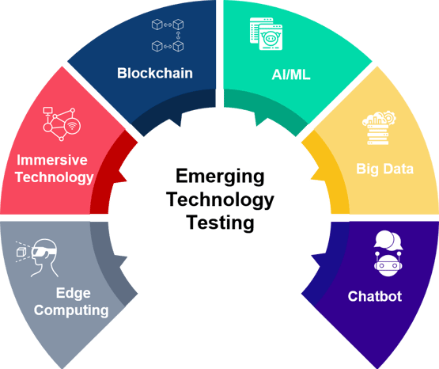
Ethics of Emerging Technologies
Emerging technologies encompass innovations that are advancing rapidly and have the potential to significantly impact various industries and societal norms.

Slide 66
Ethics of Emerging Technologies (Cont.)
Emerging technologies:
Artificial Intelligence (AI): Systems capable of autonomous decision-making, pattern recognition, and data analysis.
Blockchain: Decentralised and secure ledger technology used for transparent transactions and smart contracts.
Internet of Things (IoT): Interconnected devices and sensors that collect and exchange data to improve efficiency and convenience.
Biotechnology: Advances in genetic engineering, personalised medicine, and agricultural biotechnology.

Slide 67
Ethics of Emerging Technologies (Cont.)
Ethical Challenges:
Privacy and Data Security:
Concerns over the collection, storage, and use of personal data by emerging technologies.
Risks of data breaches, unauthorised access, and misuse of sensitive information.
Example: Use of facial recognition technology in public spaces and its implications for personal privacy and surveillance.

Slide 68
Ethics of Emerging Technologies (Cont.)
Bias and Fairness:
AI and machine learning algorithms can inherit biases from training data, leading to discriminatory outcomes.
Challenges in ensuring fairness and equity in algorithmic decision-making processes.
Example: Bias in predictive policing algorithms impacting minority communities disproportionately.

Slide 69
Ethics of Emerging Technologies (Cont.)
Autonomy and Accountability:
Autonomous technologies such as self-driving cars raise questions about responsibility and liability in case of accidents.
Challenges in defining legal and ethical frameworks for accountability in AI and robotics.
Example: Ethical considerations in the deployment of autonomous weapon systems and their implications for international humanitarian law.

Slide 70
Ethics Decision-Making in Project Management
Understanding Ethical Decision-Making
Definition and Importance
Ethical decision-making involves evaluating choices in terms of moral principles, fairness, and integrity.
Importance: Ensures transparency, builds trust with stakeholders, and mitigates risks associated with unethical behavior.

Slide 71
Ethics Decision-Making in Project Management
Key Components of Ethical Decision-Making
Identifying Ethical Issues:
Recognising situations where moral values or principles may be at stake.
Considering Stakeholder Interests:
Evaluating how decisions impact various stakeholders, including employees, customers, and the broader community.
Example: Assessing the environmental impact of project activities and stakeholders' concerns.
Applying Ethical Theories and Frameworks:
Utilitarianism: Maximising overall benefit while minimising harm.
Deontology: Adhering to moral rules and principles regardless of outcomes.
Virtue Ethics: Emphasising character traits and ethical virtues in decision-making.

Slide 72
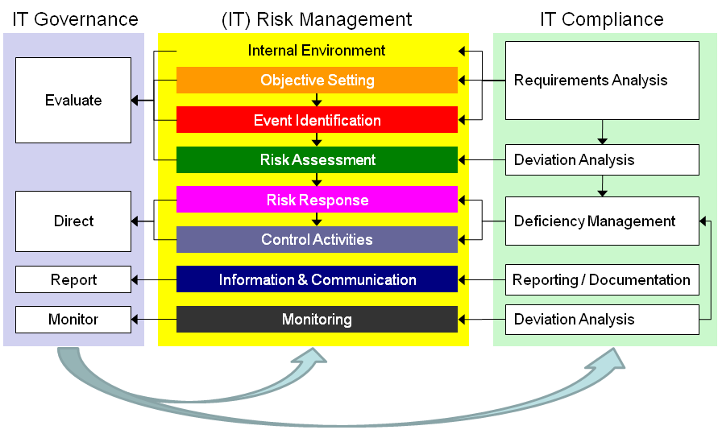
IT Governance and Compliance

Slide 73
IT Governance and Compliance (cont.)
IT governance and compliance play crucial roles in ensuring that organisations effectively manage their IT resources, align technology investments with business objectives, and adhere to regulatory requirements.
Definition and Objectives:
IT governance refers to the framework and processes that ensure IT supports and enables organisational strategies and goals.
Objectives: Enhance decision-making, manage risks, optimise resources, and ensure compliance with legal and regulatory requirements.

Slide 74
IT Governance and Compliance: Key Components
Key Components of IT Governance
Strategic Alignment:
Aligning IT strategies with business objectives to drive organisational success.
Risk Management:
Identifying, assessing, and mitigating IT-related risks to minimise potential impacts on business operations.
Resource Management:
Efficiently allocating IT resources, including budgets, infrastructure, and personnel.

Slide 75
IT Governance and Compliance: Frameworks
Frameworks for IT Governance
COBIT (Control Objectives for Information and Related Technologies)
Framework developed by ISACA (Information Systems Audit and Control Association) for governance and management of enterprise IT.
Focuses on aligning IT with business objectives, managing risks, and ensuring compliance through defined control objectives and maturity models.

Slide 76
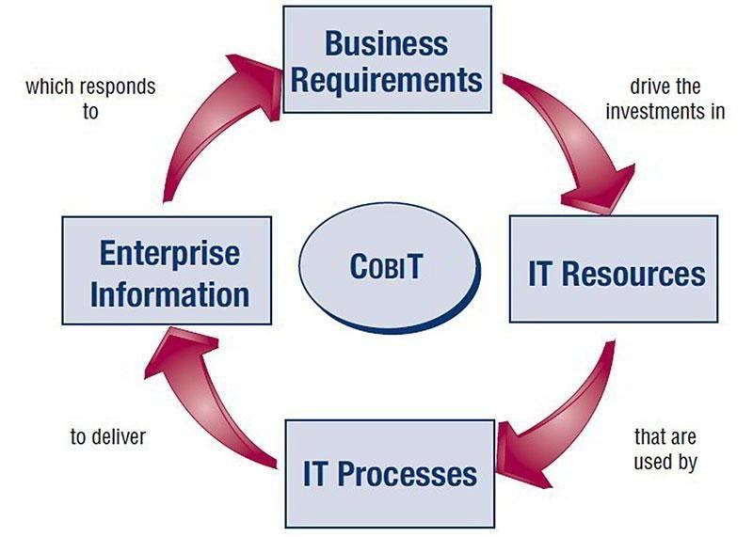
IT Governance and Compliance: Frameworks (cont.)

Slide 77
IT Governance and Compliance: Frameworks (cont.)
ITIL (Information Technology Infrastructure Library)
Set of best practices for IT service management (ITSM) that emphasises service delivery, customer satisfaction, and continual improvement.
Helps organisations align IT services with business needs and improve overall service quality and efficiency.

Slide 78
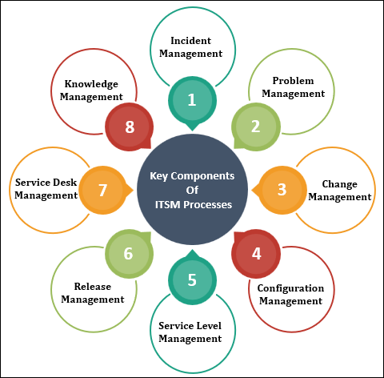
IT Governance and Compliance: Frameworks (cont.)
IT service management:

Slide 79
IT Governance and Compliance: IT Compliance and Regulatory Requirements
IT Compliance and Regulatory Requirements
Overview of Compliance Standards
Global and industry-specific regulations that impact IT operations, such as GDPR (General Data Protection Regulation), HIPAA (Health Insurance Portability and Accountability Act), and PCI DSS (Payment Card Industry Data Security Standard).
Compliance requirements vary based on organisational location, industry, and the type of data handled.

Slide 80
IT Governance and Compliance: IT Compliance and Regulatory Requirements (cont.)
Challenges and Strategies for Compliance
Challenges include keeping up with evolving regulations, ensuring data privacy, and implementing effective security measures.
Strategies involve conducting regular audits, maintaining documentation, and integrating compliance into organisational processes and IT systems.

Slide 81
Managing Stakeholder Expectations and Relationships
Effective stakeholder management is crucial for the success of IT projects, ensuring alignment between project goals and stakeholder expectations while fostering positive relationships.
Stakeholders are individuals or groups who have a vested interest in the outcomes of the project.
Examples: Clients, end-users, project team members, executives, regulatory bodies.

Slide 82
Managing Stakeholder Expectations and Relationships: Understanding Stakeholder Management
Understanding Stakeholder Management
Stakeholder Identification and Analysis
Process of identifying stakeholders and analysing their needs, expectations, influence, and potential impact on the project.
Techniques: Stakeholder mapping, interviews, surveys, and workshops to gather insights and feedback.
Types of Stakeholders
Internal stakeholders: Employees, project team members, and management within the organisation.
External stakeholders: Clients, customers, suppliers, regulatory agencies, and the broader community.

Slide 83
Managing Stakeholder Expectations and Relationships: Strategies
Strategies for Managing Stakeholder Expectations
Clear Communication
Establishing open and transparent communication channels to keep stakeholders informed and engaged throughout the project lifecycle.
Setting Realistic Expectations
Managing expectations by defining project scope, objectives, timelines, and deliverables clearly.
Addressing Stakeholder Concerns
Proactively identifying and addressing stakeholder concerns and issues as they arise.

Slide 84
Managing Stakeholder Expectations and Relationships: Building Relationships
Building and Sustaining Stakeholder Relationships
Building Trust and Credibility
Demonstrating competence, integrity, and reliability in project delivery.
Tailoring Communication Styles
Adapting communication styles and methods to meet the preferences and cultural backgrounds of diverse stakeholders.
Managing Expectations During Change
Effectively managing stakeholder expectations during project changes or unexpected challenges.

Slide 85
Group Discussion Case Study
Scenario: Implementation of AI-Powered Customer Service Chatbot
A multinational retail corporation is implementing an AI-powered customer service chatbot to enhance customer support efficiency and responsiveness. The chatbot utilises natural language processing (NLP) to handle customer inquiries, provide product recommendations, and process orders autonomously. The project aims to improve customer satisfaction and operational efficiency across global markets.
Questions:
What are some ethical concerns associated with implementing an AI-powered customer service chatbot?
How can stakeholders' expectations be managed during the implementation of AI technology in customer service?
What are some management challenges involved in deploying AI technology like a customer service chatbot?

Slide 86
Case Study: Discussion Points
What are some ethical concerns associated with implementing an AI-powered customer service chatbot?
Privacy Concerns: The chatbot collects and processes customer data, including personal information and purchasing behavior. Ensuring data privacy and obtaining consent for data usage are critical to comply with regulations like GDPR.
Bias in AI: Potential biases in the chatbot’s algorithms could result in unfair treatment of customers based on demographics or purchase history.
Transparency: Customers should be informed when interacting with AI versus human agents to maintain transparency and trust.

Slide 87
Case Study: Discussion Points
2. How can stakeholders' expectations be managed during the implementation of AI technology in customer service?
Regular communication about the capabilities and limitations of the AI chatbot.
Addressing concerns and feedback from stakeholders through surveys and feedback mechanisms.
Providing training to employees on how to work alongside AI systems to maintain customer satisfaction.

Slide 88
Case Study: Discussion Points
3. What are some management challenges involved in deploying AI technology like a customer service chatbot?
Balancing project timelines with ethical considerations and testing phases.
Ensuring compliance with data privacy regulations such as GDPR.
Mitigating risks associated with technical failures and maintaining customer trust.

Slide 89
Summary
Ethical and management issues in IT projects encompass a range of considerations crucial to project success and stakeholder trust.
Ethical Considerations:
Privacy concerns surrounding data collection and usage in AI and technology implementations.
Addressing biases in AI algorithms to ensure fair treatment and decision-making.
Transparency in technology adoption to maintain trust and accountability.
Management Challenges:
Balancing project timelines with rigorous testing and ethical guidelines to deliver high-quality outcomes.
Managing stakeholder expectations through clear communication and feedback mechanisms.
Mitigating risks such as technical failures and regulatory compliance issues during project implementation.

Slide 90
Q&A
Question?

Slide 91
Week 10 Workshop :
Ethical and Management Issues in IT Projects
ICT502
ICT502 Applied IT Project A
91

Slide 92

The ethics of information technology
Some of the major ethical issues faced by Information Technology (IT) are:
1. Personal Privacy
2. Access Right
3. Harmful Actions
4. Patents
5. Copyright
6. Trade Secrets
7. Liability
8. Piracy

Slide 93
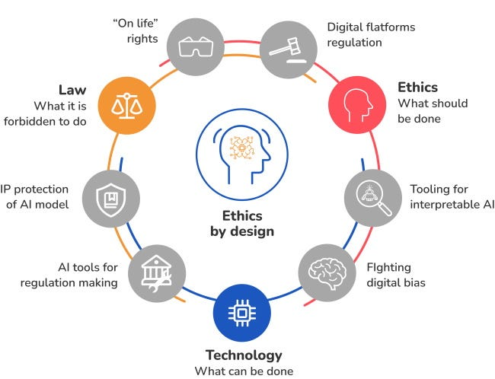
The ethics of information technology (cont.)

Slide 94
Ethical Considerations in Big Data
Ethical considerations in the realm of Big Data are increasingly crucial as data-driven technologies shape various aspects of society. Understanding these ethical dimensions is essential for ensuring responsible use of data and maintaining trust in data-driven innovations.
Privacy: Protection of personal data from intrusive collection and analysis.
Bias: Mitigating biases in algorithms to ensure fairness in decision-making.
Transparency: Establishing clear processes for data handling to uphold accountability.
Security: Ensuring robust cybersecurity measures to prevent data breaches and protect sensitive information.

Slide 95
Ethical Considerations in Big Data
Consent: Empowering individuals with informed consent over data usage.
Ownership: Defining rights and responsibilities regarding data ownership and stewardship.
Long-Term Impact: Considering societal implications of data practices on future generations.
Environmental Responsibility: Minimising the environmental footprint of data infrastructure and operations.

Slide 96

Video: How to Manage Difficult Stakeholders
Have you been dealing with stakeholder challenges? (Watch in 11 minutes)
Watch this video to learn :
https://www.youtube.com/watch?v=NaGhBpfZLzg

Slide 97
Video: How to Manage Difficult Stakeholders
Key lessons/messages from the video: Managing Difficult Stakeholders
1. Difficult stakeholders are common in projects
Almost every project has:
- disagreements,
- challenging people,
- communication problems,
- or difficult stakeholders.
Project managers must learn how to manage these situations professionally.

Slide 98
Video: How to Manage Difficult Stakeholders
2. Set expectations early
At the beginning of the project:
- explain roles,
- responsibilities,
- meeting behaviour,
- and communication expectations.
This helps reduce confusion and conflict later.

Slide 99
Video: How to Manage Difficult Stakeholders
3. Use project documents clearly
Important documents like:
- project charters,
- meeting rules,
- and project agreements
should clearly explain expectations and responsibilities.

Slide 100
Video: How to Manage Difficult Stakeholders
4. Follow up on agreed behaviour
Rules only work if they are enforced.
If someone behaves inappropriately:
- speak with them professionally,
- refer to agreed project expectations,
- and discuss the issue calmly.

Slide 101
Video: How to Manage Difficult Stakeholders
5. Find the real cause of problems
Do not assume why someone is difficult.
The real problem could be:
- misunderstanding,
- poor communication,
- hidden concerns,
- stress,
- or disagreement about project decisions.

Slide 102
Video: How to Manage Difficult Stakeholders
6. Use the “5 Whys” technique
Keep asking “Why?” to identify the root cause of the issue.
This helps uncover the real problem instead of only seeing surface-level complaints.

Slide 103
Video: How to Manage Difficult Stakeholders
7. Stay calm and listen
Good project managers:
- stay professional,
- listen carefully,
- avoid emotional reactions,
- and try to understand stakeholder concerns.

Slide 104
Video: How to Manage Difficult Stakeholders
8. Do not accept abusive behaviour
Listening is important, but abuse is not acceptable.
If someone becomes abusive:
- stop the conversation,
- and continue later professionally.

Slide 105
Video: How to Manage Difficult Stakeholders
9. Make stakeholders feel heard
People become less angry when they feel listened to.
Repeating back their concerns helps build trust and understanding.
Example:
“If I understand correctly, your concern is…”

Slide 106
Video: How to Manage Difficult Stakeholders
10. Find common ground
Even difficult stakeholders usually want project success.
Focus on:
- shared goals,
- project scope,
- and business objectives.

Slide 107
Video: How to Manage Difficult Stakeholders
11. Address issues early
Ignoring problems usually makes them worse.
Project managers should deal with conflicts quickly and professionally.

Slide 108
Video: How to Manage Difficult Stakeholders
12. Compromise can help projects succeed
Compromise is not weakness.
Sometimes small adjustments:
- improve teamwork,
- reduce conflict,
- and help stakeholders support the project.

Slide 109
Video: How to Manage Difficult Stakeholders
13. Main lesson
A good project manager is not only focused on tasks and deadlines. They must also:
- communicate well,
- manage relationships,
- listen carefully,
- and handle conflicts professionally.

Slide 110
Discussion Questions
Who is considered a stakeholder in a project?
A stakeholder is anyone involved in or affected by the project, such as team members, managers, clients, sponsors, or users.
2. Why is it important to set expectations early?
Clear expectations help reduce misunderstandings, confusion, and conflict during the project.

Slide 111
Discussion Questions
3. What is the purpose of the project charter?
The project charter explains project goals, responsibilities, expectations, and agreed rules for stakeholders.
4. Why should project managers listen carefully to stakeholders?
Listening helps project managers understand concerns, reduce conflict, and build trust.

Slide 112
Discussion Questions
5. What is the “5 Whys” technique?
It is a method of repeatedly asking “Why?” to identify the real root cause of a problem.
6. Should project managers accept abusive behaviour from stakeholders?
No. Project managers should remain professional but stop conversations if behaviour becomes abusive.

Slide 113
Discussion Questions
7. Why is compromise important in projects?
Compromise helps teams work together, improves stakeholder support, and reduces unnecessary conflict.
8. What can happen if project conflicts are ignored?
Ignored problems often become bigger issues that can damage teamwork and project success.

Slide 114
Discussion Questions
9. How can NSW IT Support benefit from good stakeholder management?
Good stakeholder management can improve communication, client satisfaction, teamwork, and project success.
10. What is the main lesson from the video?
Successful project management requires strong communication, active listening, professionalism, and good relationship management.

Slide 115
Workshop Activity 1
Scenario 1: Development of a Mobile App for Healthcare
A healthcare startup is developing a mobile app to enhance patient engagement and remote healthcare services. The project involves collaborating with healthcare providers, regulatory bodies, and technology partners to ensure compliance with healthcare standards and data privacy regulations. However, stakeholders have diverse opinions on app features, data security, and usability, leading to challenges in consensus-building and decision-making.
Discuss in your groups:
How can stakeholder engagement contribute to the success of a healthcare app development project?
Why is regulatory compliance important in developing healthcare-related IT projects?
What are some strategies for resolving conflicts between stakeholders with differing opinions on app features and functionality?

Slide 116
Workshop Activity 2
Scenario 2: Ethical Issues in Implementing Facial Recognition Technology
A metropolitan city government decides to implement facial recognition technology (FRT) as part of its public safety initiative. The project aims to enhance security measures in public spaces, monitor criminal activity, and improve law enforcement efficiency. However, the deployment of FRT raises significant ethical concerns regarding privacy, bias, transparency, and social implications.
Discuss in your groups:
What are the primary ethical concerns associated with the deployment of facial recognition technology in public spaces?
How can city governments address the ethical dilemma of balancing public safety with individual privacy rights when implementing facial recognition technology?
What role do technology providers play in addressing ethical concerns related to facial recognition technology?

Slide 117
Workshop Activity 3: Open Questions
Discuss in your group with the help of an online search platform:
How does facial recognition technology impact individuals' privacy in public spaces?
What are some potential risks of algorithmic bias in facial recognition technology?
Why is transparency important in the deployment of facial recognition systems?
What ethical considerations arise from using facial recognition in law enforcement?
How might societal norms be affected by widespread adoption of facial recognition technology?
What roles can stakeholders play in addressing ethical concerns related to facial recognition technology?

Slide 118
Workshop Activity 4: Infographic summary
◆ Students are required to list the concepts that have been covered in the reading materials and lecture and group them by their category.
◆ Use an online tool (such as https://www.canva.com/ ) to produce the infographic summary to be submitted and present to the class.

